Slide 1
Team 2
Haruna Tanaka, Nicholas Mehr, Toshinori Kitamura,
Xiaobai Sun, Masayuki Takeda, Kai Ru

Slide 2
NLP
The process of creating algorithms that transform some language input like text or audio into words, labeling them based on the position and function of the words in the sentence.
Intro to NLP and Language Models Part 1 NLP, Applications, Challenges
Continuous Bag of Words model (CBOW)
Word embeddings

Slide 3
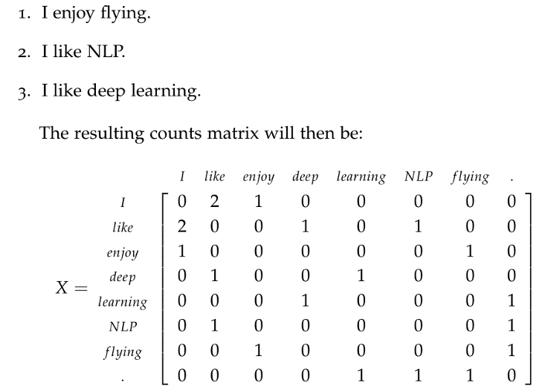
Continuous Bag of Words model (CBOW)

Slide 4
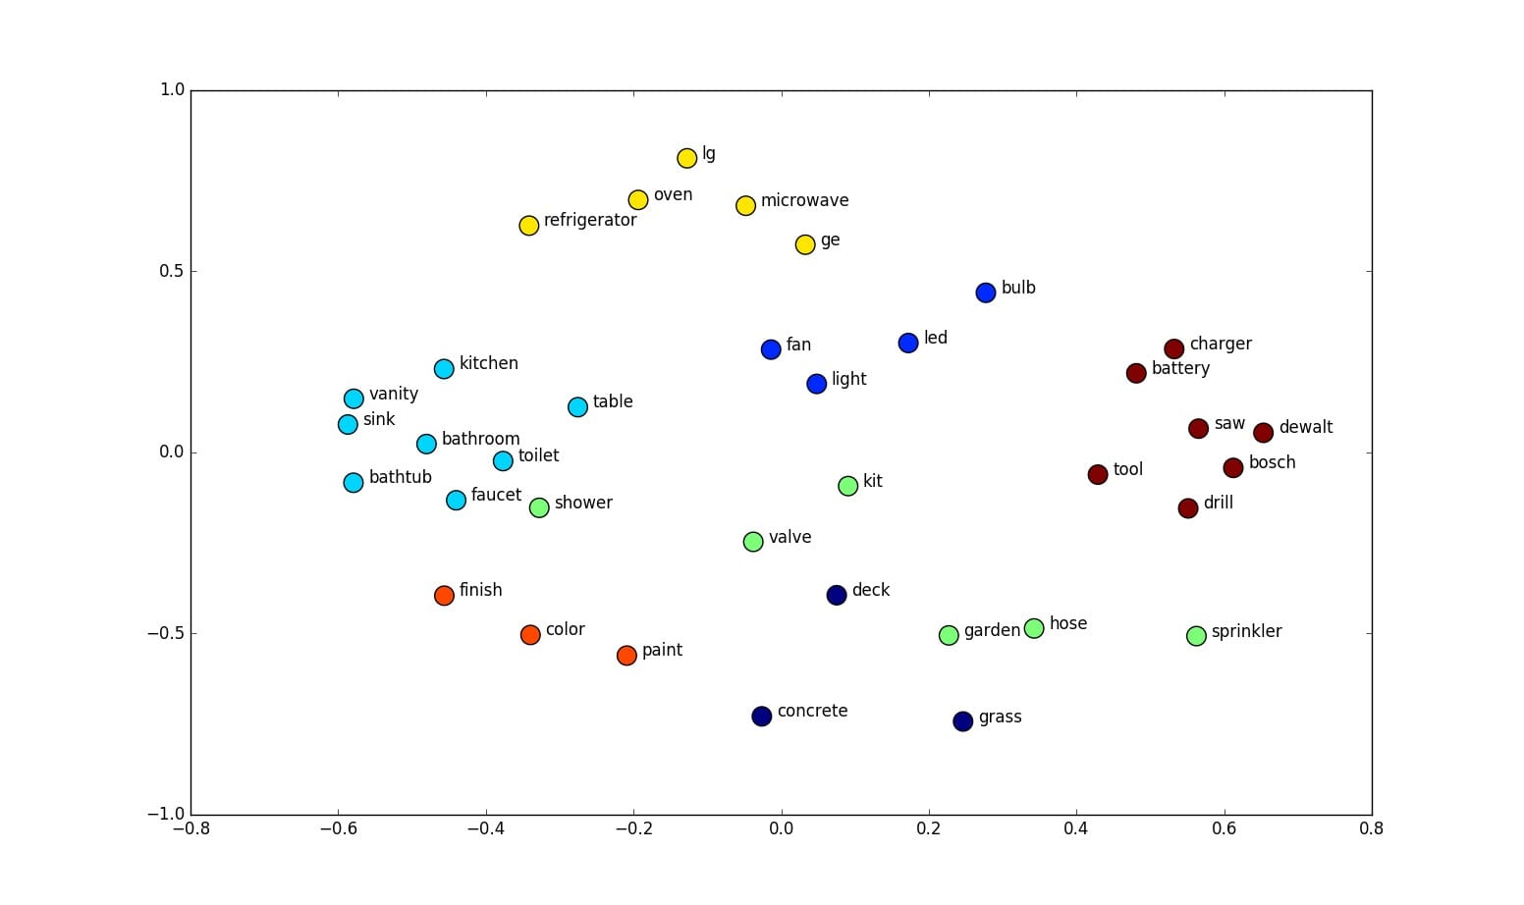
Word embeddings, an N-dimensional vector representation of human words, are needed to create meaningful inputs.

Slide 5
Applications
Machine Translation
Speech Recognition
Sentiment Analysis
Question-Answering
Automatic Summation
Chat-bots
Market Intelligence
Text Classification
Character Recognition
Spell Checking

Slide 6
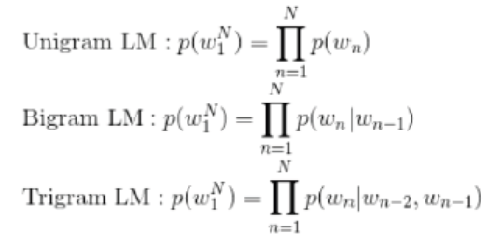
Intro to NLP and Language Models Part 2: Statistical vs neural networks and conventions of neural network architecture
1) Statistical Language Models
N-grams
Hidden Markov Models
Hard-coded linguistic rules
N-Gram Models:
Limitations of N-gram models:
Simplest language model, cannot achieve fluency
Higher N leads to computational overhead
Crude representation of language built on the probability of words co-occurring, i.e., gives zero probability to all the words that are not present in the training corpus.
Rudimentary Example:
P(w|h)
P(the|its water is so transparent that)

Slide 7
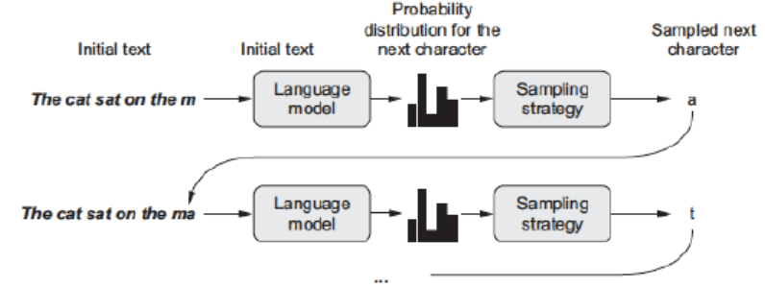
Intro to NLP and Language Models Part 2: Neural networks and conventions of neural network architecture
2) Neural Language Models
LSTMs
Bi-directional models/attention Mechanisms
Implementing Character-Level Networks:
Advantages over N-Gram models
Can introduce randomness in the sampling process via stochastic sampling.
Probabilistic sampling from Softmax output can generate new or realistic words not in training data

Slide 8
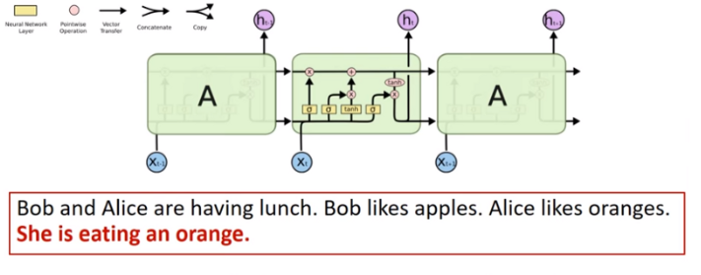
Intro to NLP and Language Models Part 2: Neural networks and conventions of neural network architecture
2) Neural Language Models
LSTMs
Q&A Application (right)
Input/Forget/Output Gates (below)

Slide 9
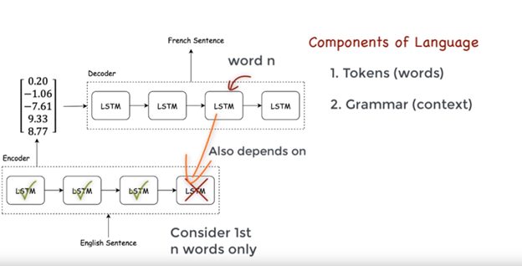
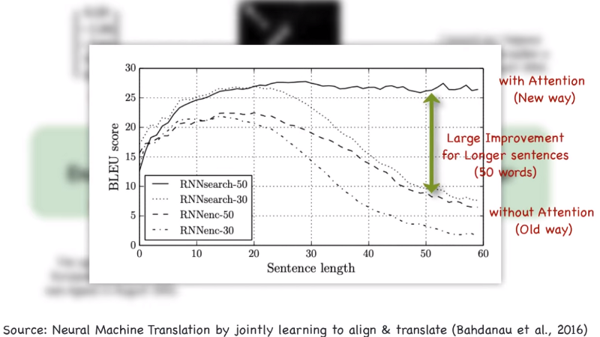
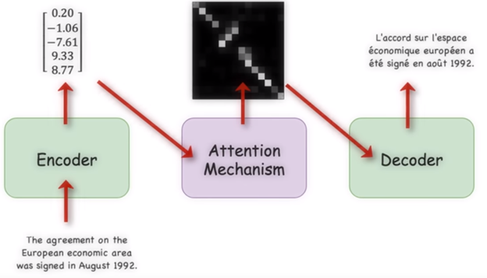
Intro to NLP and Language Models Part 2: Neural networks and conventions of neural network architecture
2) Neural Language Models
Attention mechanisms
Why we need Attention mechanisms:
Single-directional encoder-decoder does not adequately address complexity of grammar in longer sentences.
Solution: make bi-directional LSTM
New problem: which word do we need to focus on in a sequence?

Slide 10
How Conventional Approach Deal With Language Model

Slide 11
CNN
・Convolution approaches to language models use probabilistic description of language phenomena.
・Probability comes in handy in determining
・Currently, nearly all techniques of text classification are word based.

Slide 12
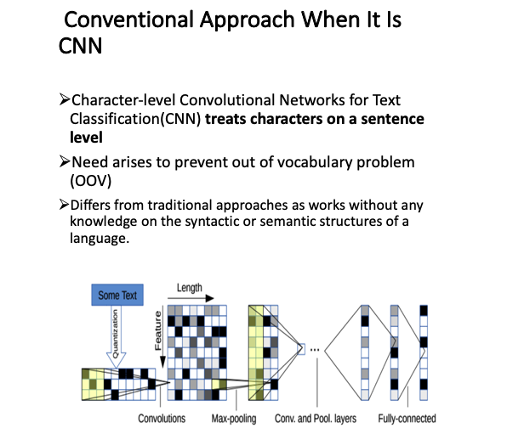

Slide 13
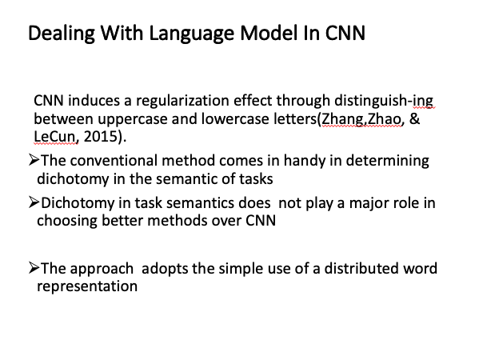

Slide 14
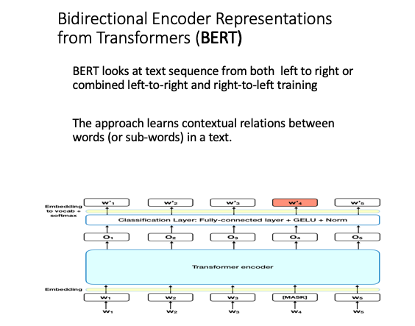

Slide 15
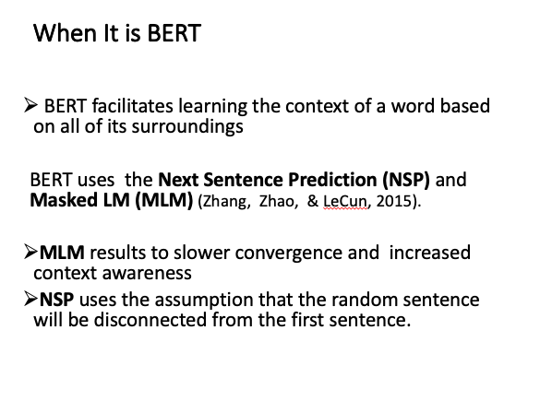

Slide 16
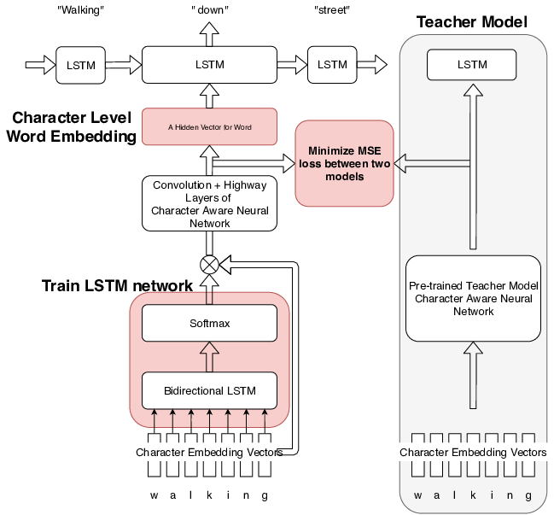
Proposed Model Architecture
Fig. Model architecture

Slide 17
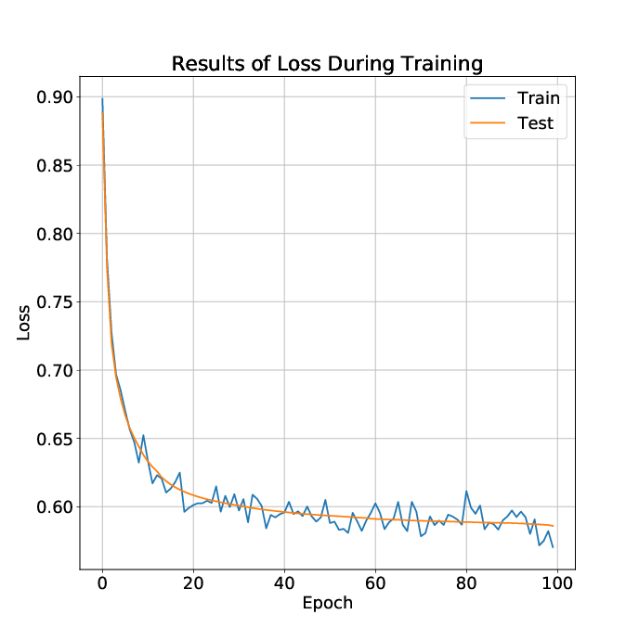
Results(training loss)

Slide 18
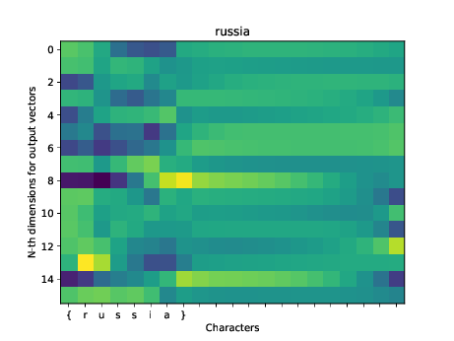
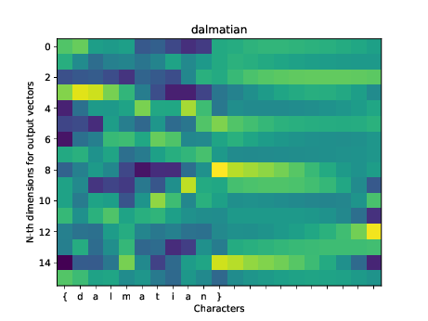
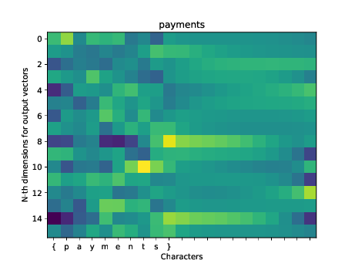
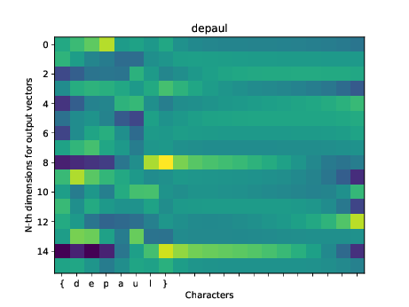
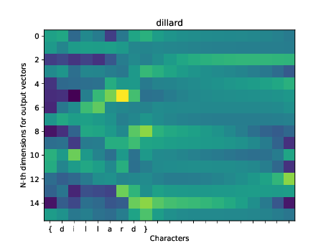
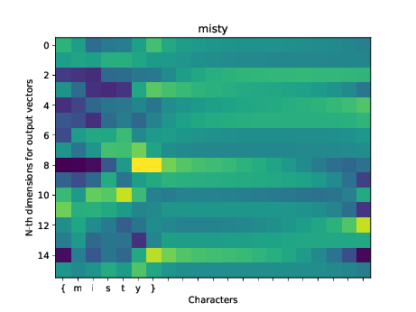
Results(visualization of gate map)

Slide 19
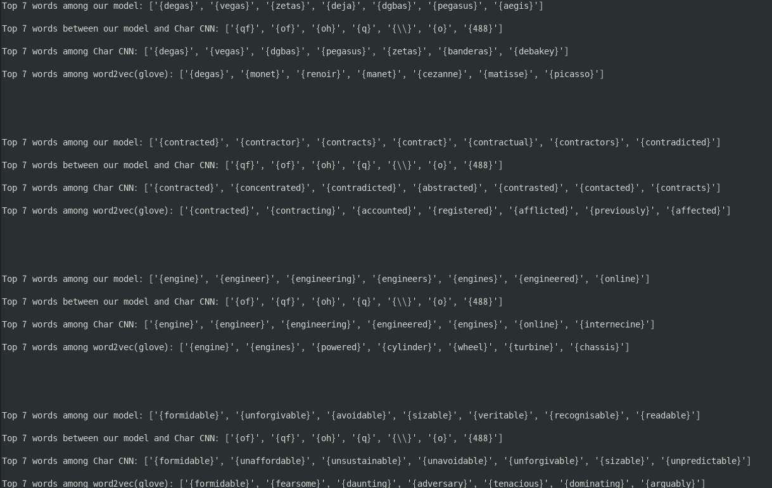
Results(closest words)

Slide 20
Conclusion
What we did
We buit Bidirectional LSTM to implement a Gate for input character embeddings
Gate is expected to reduce inputs
How were the results
Loss is decreased
Proposed network could find similar character word
Proposed network could not find the morph gaps
Proposed network could not learn the embedding of teaching model
How to improve
We should add loss about second or third similar hidden layers
We should implement mutual information into loss
Character aware NN is not suited for learning because it is not good to find similar words

Slide 21
word embedding distillation
regress Kim (2016)’s CharCNN without LSTM on BERT emeddings
subword segmented
static vs. contextual: Ethayarjah (2019)
word embedding-based morphological segmentation
cosine similarity to detect morpheme boundaries (Üstün and Can, 2016): mt-caret/morpholine
deriving suffix/prefix morpheme translation rules from word embedding regularity (Soricut and Och, 2015)
oov problem
solve via subword segmentation
BPE-based (Sennrich et al., 2016), subword regularization (Kudo, 2018), WordPiece (Google NMT) (Wu et al., 2016)
compose word embeddings from subword embeddings
fasttext (Bojanowski et al., 2017), Botha and Blunsom, 2014
fasttext-subword-interpreter model
subword attention
fasttext-subword-attention model

Slide 22
Morphological analysis using FastText
Distillation from BERT easily converges to local minima
Learning word meaning from characters is difficult?
Fasttext: Better trained model for morphological analysis?
FastText
Language modeling with subwords:
e.g. “where” → <wh, whe, her, ere, re>
Word embedding for each subwords
Train the language model with the subword embeddings

Slide 23
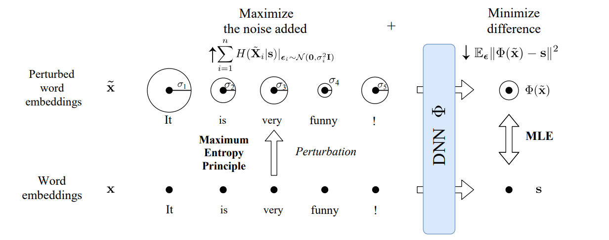
Morphological analysis using FastText
...
Language modeling
Mutual information analysis [Chaoyu et al. 2019]
Encoded vector
Transformer Encoder x 4
...
Subword embeddings
...
“where” → <wh, whe, her, ere, re>

Slide 24
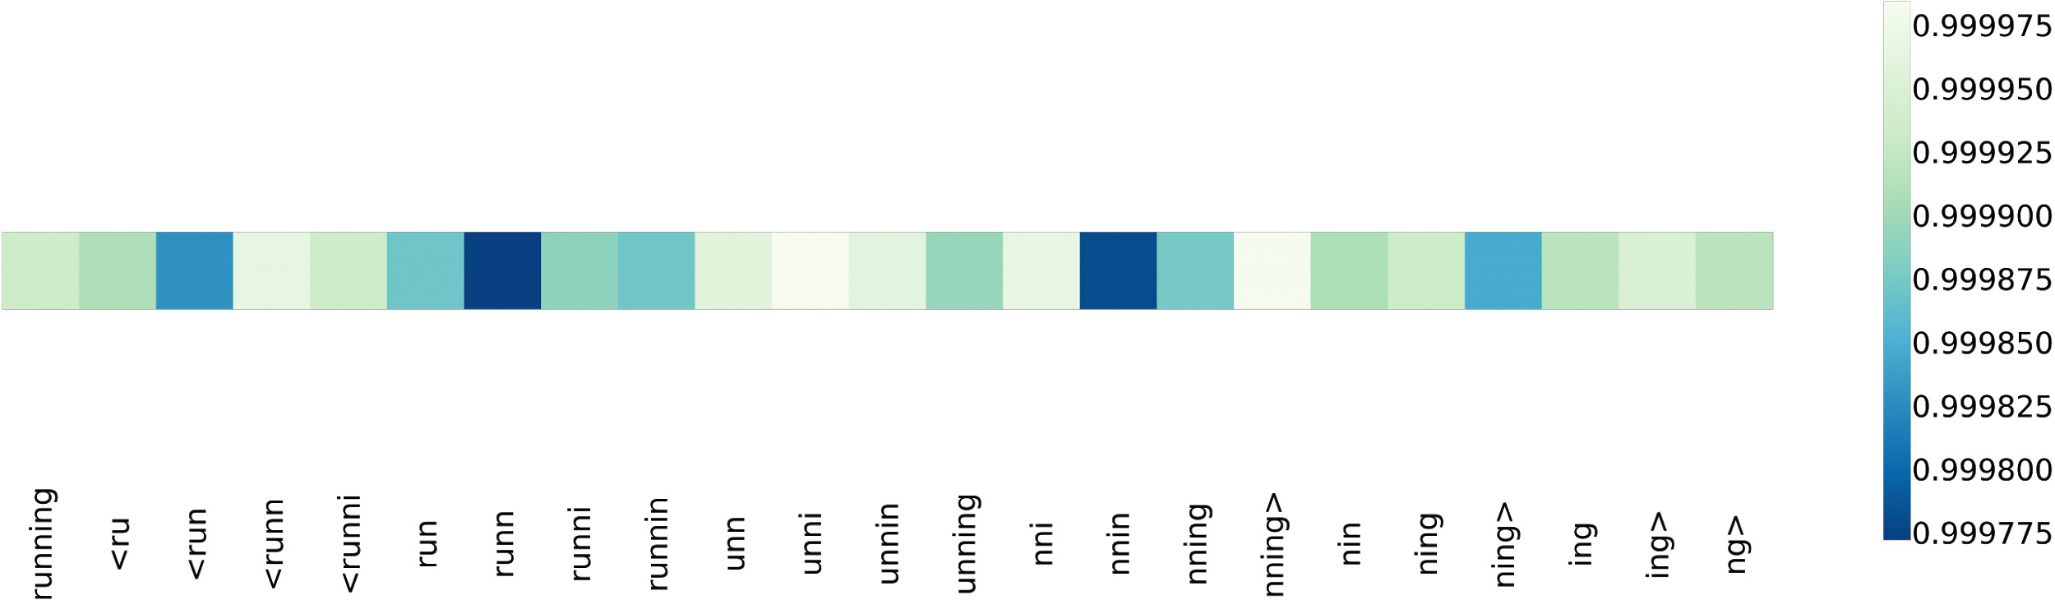
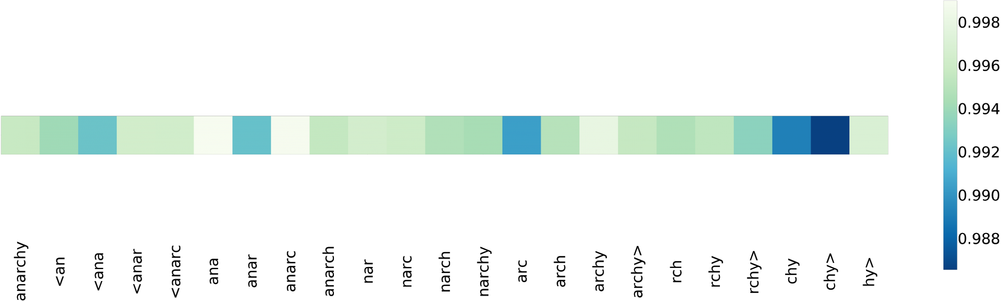
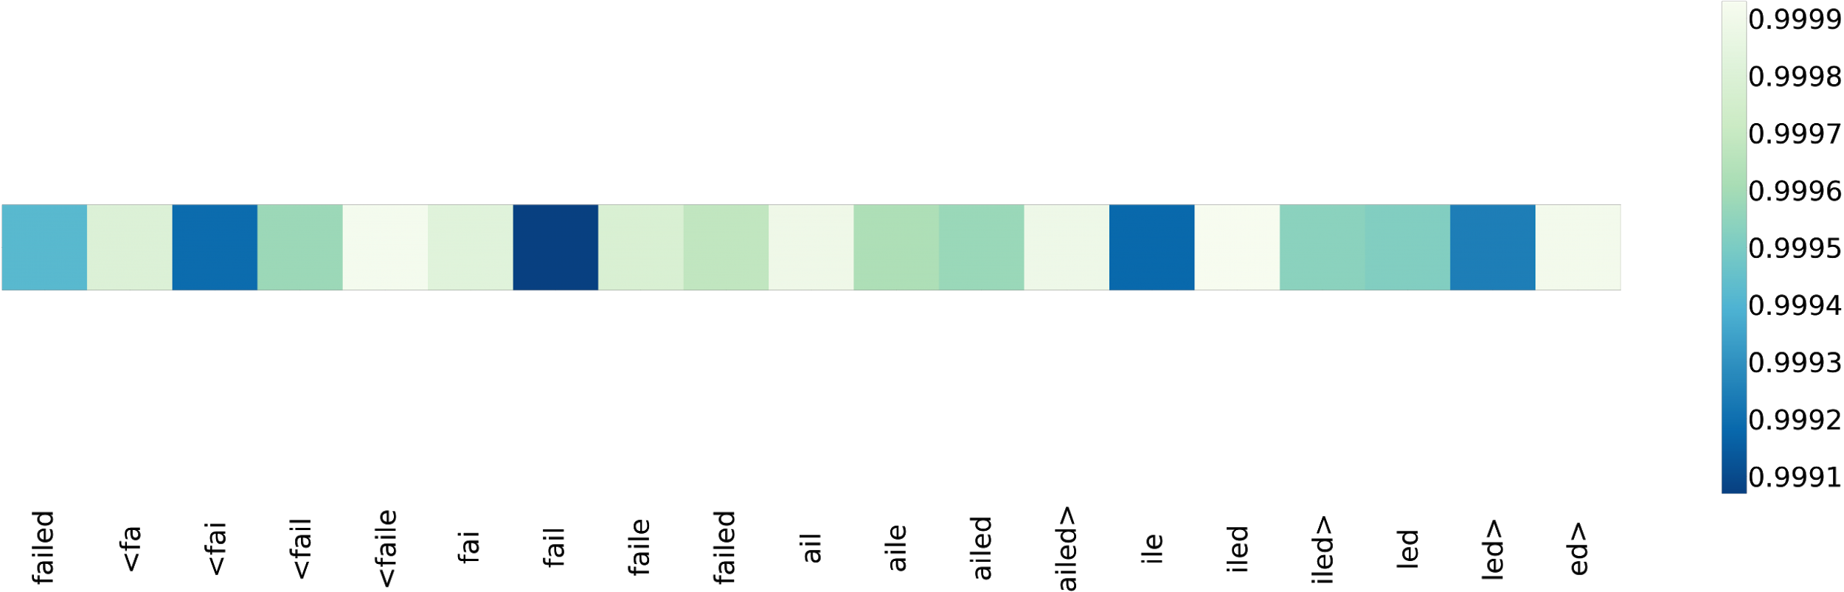
Results(FastText)
“running”
Top 5 important words: ['runn', 'nnin', '<run', 'ning>', 'run']
“anarchy”
Top 5 important words: ['chy>', 'chy', 'arc', 'anar', '<ana']
“failed”
Top 5 important words: ['ed>', '<faile', 'iled']

Slide 25
Issues
dataset size
concerns with implementation
models don’t get that good at language modeling
interpreter implementation is iffy (sigma for words are very high, learning is unstable)

